Slide 1


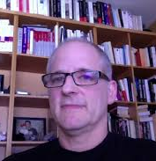

MDE WITH PAPYRUS
novelties and beyond
Florian Noyrit
On Behalf of
Sebastien GERARD
CEA Tech / LIST, France
sebastien.gerard@cea.fr
Francis Bordeleau
Ericsson, Canada
francis.bordeleau@ericsson.com
Notes:
Abstract: Following last year’s promotion beyond incubation status, Papyrus continues to evolve as an industrial-strength facility. Most recently major progress has been achieved in the following three key areas: (i) enhancing the user experience, (ii) improvements in performance and scalability, and (iii) greater robustness and stability. In this talk we first describe the advances made in these general aspects as well as the development of new capabilities and enhancements in support of domain-specific modeling languages. To that end, Johan Hardy of Spacebel will describe their experience with the Papyrus tool in the space applications domain.
In addition to providing the above technical improvements, the Papyrus team has also expanded significant effort towards the development of a broad open-source community dedicated to Papyrus and its ecosystem. Consequently, the second part of the talk is devoted to the forthcoming establishment of the Papyrus User Consortium, which is an open community of industrial users whose role is to steer the evolution of Papyrus to ensure that it will meet their current and future needs. This is described by Francis Bordeleau of Ericsson, who is one of the primary drivers behind this initiative.
Finally, we will present the current roadmap for Papyrus and its ecosystem.

Slide 2

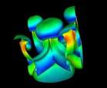



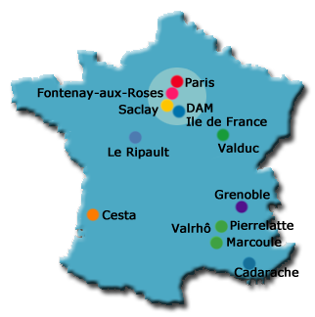


CEA key figures
CEA is a major actor in research and innovation.
Direction of CEA
16 000 people
16 centers in France
Budget : 4,3€ bilions
1 600 patents
4 000 publications / year
150 startup created since 1984
Technology
Defense
Security
Military Applications Division
Nuclear
Energy
Nuclear Energy
Division
Key Enabling
Technologies
CEA-Tech
Science
Fundamental research
Physical Sciences Division
Life Sciences Division

Slide 3

The LISE labs in a nutshell
Correct-by-construction design of safe CPS
A laboratory of 50 persons (+ 5 new permanent open positions for 2015… ;-))
33 permanent members + 17 non-permanent members including PhD students, post-docs and CDDs
Model-based Formal Analysis (e.g., auto gen. of tests)
Model-based Simulation
Process, Requirement and Variant Engineering
Run-time Formal Verification and Monitoring
Archi. Exploration, Configuration & Deployment
Model-based Security & Safety Engineering
Modeling Language Engineering
Main research concerns

Slide 4
Agenda
About Papyrus 1.1.3
Ericsson: Papyrus deployment
What next?

Slide 5

And now…
v.1.1.3
http://www.eclipse.org/papyrus

Slide 6


The main Concerns of the Papyrus team
1.1.3
Usability
Robustness
Performance
Customizability & configurability
Conformity
to MDE-standards
Maintainability & Evolvability
✔

Slide 7
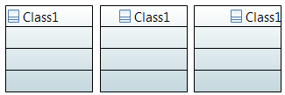
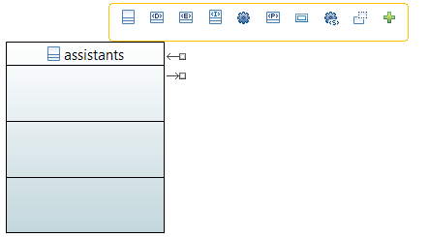
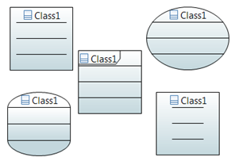
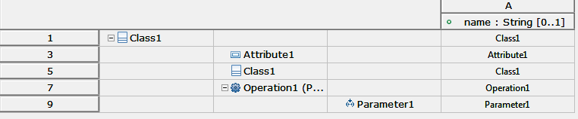

New features highlights
Dynamic shape customization
Modeling Assistants
Tree Table editors
Rich text support
Information synchronization
Model View
View View
Diagram expansion
Extend existing diagram editors to create specific ones
Support for ALF modeling

Slide 8







Main ImProved features
Project and model creation wizards
Papyrus Navigation
Search UI
Papyrus EMF Compare
Stereotype support
Activity diagram editor has been finalized
RSA import
Table filters (including numeric and regex filters)
Improve CDO integration within Papyrus
«»

Slide 9


For successful FOSS, Community is a prime-concern

Slide 10







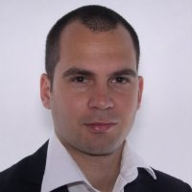

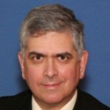

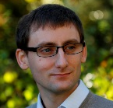
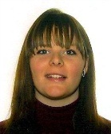

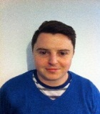
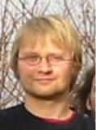



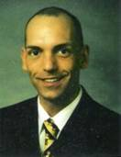
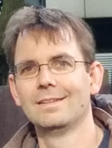

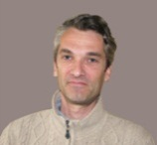


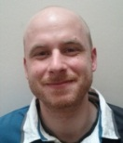




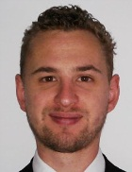



A world-class international development team
A. Henriksson
Ericsson
S. Dhouib
CEA
A. Le Guennec
Esterel Tech.
P. Langer
EclipseSource
Ed. Willink
Ed Willink T.
J.-M. Bruel
IRIT
B. Maggi
CEA
F. Jouault
ESEO
J. Tatibouët
CEA
C. Rivet
Zeligsoft
M. Golubev
Montages
F. Bordelau
Ericsson
F. Noyrit
CEA
C. Janssens
All4Tec
R. Schnekenburger
CEA
G. Pascual
All4Tec
S. Gérard
CEA
C. Damus
Independant
K. Hussey
Commiterati
S. Redding
Zeligsoft
B. Marques
CEA
P. Tessier
CEA
A. Tischenko
Montages
E. Stepper
es-computersys.
A. Radermacher
CEA
E.Seidewitz
MDS
O. Beaudoux
ESEO
P.-A. Gussander
Nigus
O. Gürca
CEA
C. Dumoulin
Independant
Q. Le Menez
CEA
C. Letavernier
CEA
M. Golubev
Montages
Sébastien Gabel Esterel Tech.
A. Cucurru
CEA
J. Cadavid
CEA
S. Boyko
Montages
M. Adam
All4Tec
M. Elaasar
Crossplatform Sw
M. E. Alferez Salinas
CEA
B. Selic
Malina Software Corp.

Slide 11
Some figures to outline the Papyrus community
#commits
1270 tasks closed (including bug fixing and enhancement) from July 2014 to June 2015!
A large international community
#Committers | #Average commits PM | #Ext. contributors | #Ext. contribution accepted via gerrit PM
19 | 300 | 30 | 150
 External contributions via Gerrit

Slide 12
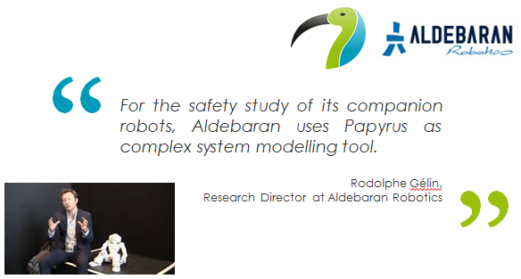

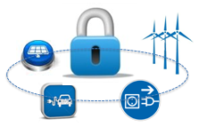






















Papyrus Exploitation
SESAM-Grids
Goal is to develop an integrated modeling, development, validation and testing framework for leveraging the cost-efficient and reliable implementation of ETCS: Papyrus has been chosen for modeling concerns.
Papyrus chosen for modeling control command system of next generation of nuclear plant.

Slide 13






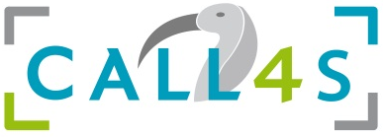
Examples of Papyrus Deployment at industrial level
Esterel Tech. and CEA LIST create an innovative lab on
Critical systems and software development tools and processes
2009
Sherpa Engineering and CEA LIST create an innovative lab on
Control engineering in the automotive domain
2011
All4Tec and CEA LIST create an innovative lab on
Model-based system engineering and safety analysis
2012

Slide 14
Agenda
About Papyrus 1.1.3
Ericsson: Papyrus deployment
What next?

Slide 15

5 Years of “Papyrusing”
Francis bordeleau, Ronan Barrett Ericsson AB
Based on a paper published at OSS4MDE ‘15

Slide 16



Motivation
Active research/support Community
Textual Integration
No license costs
Collaborative development process
Simple Installation
One install many tools
Notes:
Low or zero license cost per user
Textual modeling integration
Simple installation (local and centralized)
Two way tool platform collaborative development process
Tool co-location in same Eclipse workspace
Active research & support community
Carrot Icon credit to : www.cloudriven.fi

Slide 17

Tool Use Case
We Can have 1000+ classes and 10,000+ properties
Modeling Tool
Our “DNA” makes Mobile Communication possible!
O&M Interface
Managed Elements
Notes:
Super quick run through of the context

Slide 18



Assumptions
Notes:
A UML platform is required as our O&M models are object orientated
Diagrams are needed to communicate models to users
The cost of building our own UML tool cannot be justified
The Eclipse platform is desirable due to the tooling ecosystem available there e.g. File management, version control integration, Compare/Merge, etc.
Open source solutions should be used if possible
Open source picture from http://vufind-org.github.io/vufind/images/opensource.svg.png
DIY Logo from http://www.bydesignwaco.com/wp-content/gallery/logos/diy-logo.jpg

Slide 19
Engagement
Notes:
These are the important releases of Papyrus to us in DX

Slide 20
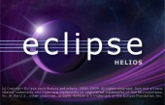

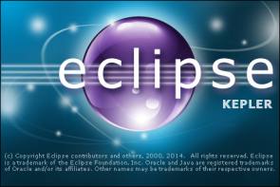

Papyrus Engagement
2010 Helios
2015 Luna
Notes:
Indigo was not assessed

Slide 21

Engagement Numbers
5x
5x
4x
Bugs Filed
9x
Notes:
5 years
4 release trains
147 bugs reported by me on Papyrus
35 not fixed yet (non critical)
Other Ericsson bugs not reported by me were also fixed
5 Luna service releases
9 evaluations

Slide 22
Lessons Learned
Notes:
These are the important releases of Papyrus to us in DX

Slide 23

Communication
Long Email
Write a Bugzilla
Ericsson Engineer
Papyrus Engineer
Call me!
Long Document
Screen Share
Notes:
Animate the left side
Work together on solution
One Ericsson engineer paired with one Papyrus engineer
No long emails/documents
Define issue in Bugzilla
Discuss problem on the phone
Use screen sharing to explain use cases
Papyrus engineer develops feature/fixes bug
Ericsson engineer tests feature/bug

Slide 24
How to Evaluate?
+
Your Needed Features
Your Test Coverage
-
=
Preconceptions
O&M
Modeling
+
Supporting
Documentation
Your Evaluation
Notes:
Must be quantifiable
What context
Level of testing in what contexts
Documentation
APIs etc
Saying one tool is “better” than another without justification is not scientific or helpful

Slide 25
Conclusions
Is Papyrus good enough to be used in industry?
Yes it is in many, but probably not all, contexts today
If it doesn’t meet your requirements then get involved
Don’t try to build our own DSL/UML Tool
Instead become a contributor and together we can build a great tool
In open source there is no customer vendor relationship
Don’t ask for non generic features
Communicate openly and effectively
Papyrus is only one part of a larger eco system
Manage integration of other components carefully
Expectations must be managed
No false starts
Don’t release until you have the “right quality”
Notes:
To be redone

Slide 27
Agenda
About Papyrus 1.1.3
Ericsson: Papyrus deployment
What next?

Slide 28
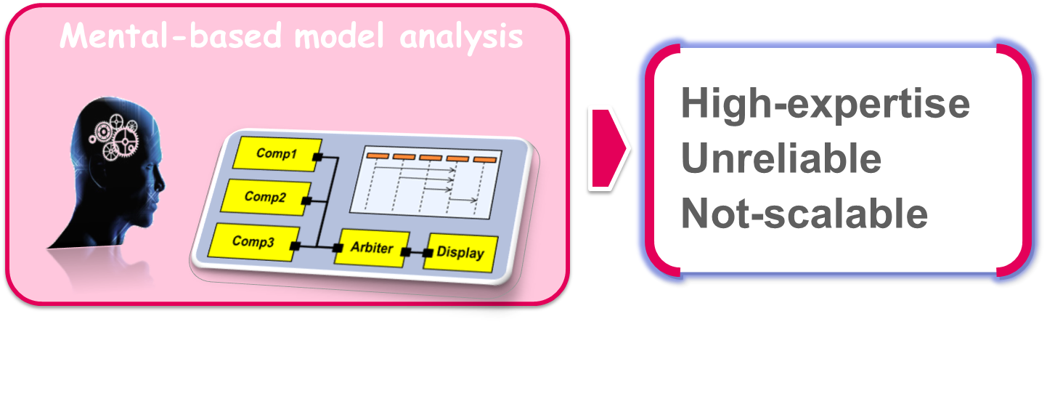
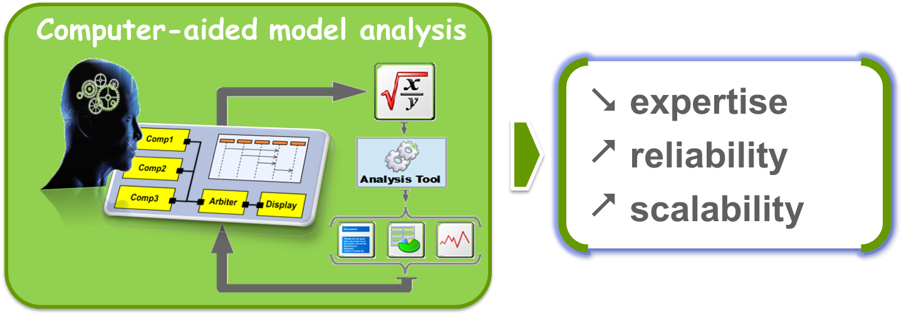
Improving model exploitation: from mental to computer-aided analysis.

Slide 29








Papyrus extensions for a full-fledged and powerful MDE solution
Safety/Security
Model-based Simulation
Model-based formal-analysis
( incl. MBTesting )
Analysis-driven Architecturing
Product Line
RequirementsEngineering
Model-based Monitoring

Slide 30

Outline of the roadmap for Papyrus 1.2 (Eclipse NEON)
1.2
Customizability
Robustness
Performance
Usability
Papyrus-Req
Papyrus-Manuflex
Papyrus-FM
Standards Conformity
Papyrus-RT
Maintainability & Evolvability

Slide 31




Direction DRT Département DILS Laboratoire LISE
A maintenance agreement for Papyrus
Commercial support
Created middle of 2014, with trained Papyrus developpers
Commissariat à l’énergie atomique et aux énergies alternatives
Institut Carnot CEA LIST
Centre de Saclay | 91191 Gif-sur-Yvette Cedex
T. +33 (0)169 077 093 | M. +33 (0)688 200 047
Etablissement public à caractère industriel et commercial | RCS Paris B 775 685 019

